Slide 1

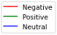
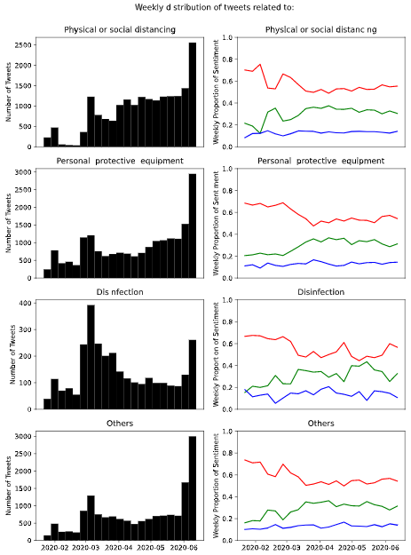
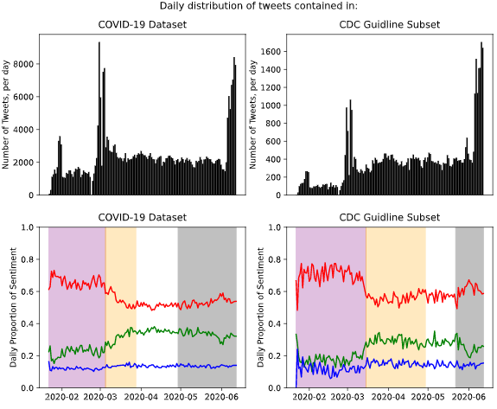

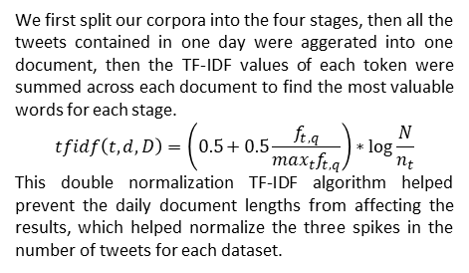
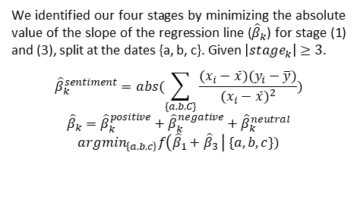
Topics and Sentiment of COVID-19 in Twitter:
A look into how and what the US was talking about during the pandemic.
Alexander Kahanek, Lingzi Hong
(Department of Information Science, University of North Texas), alexanderkahanek@my.unt.edu
Purpose of our study
What is our COVID-19 Dataset?
What is our CDC Subset?
We identified four stages of sentiment patterns and used those stages to identify the most valuable topics in each. This showed differences of how and what was being talked about between COVID-19 and the CDC guidelines.
We collected tweets that are related to COVID-19, from January 21, 2020 to June 12, 2020. We separated our tweets to be only those that were tweeted in the United States. These tweets were then filtered for possible non-human accounts by using the ratio of friends and followers. (n = 344218)
We identified four categories of keywords from published CDC guideline documents. We then filtered our COVID-19 data for tweets that contained at least one of these keywords from the CDC guidelines. (n = 53272)
How did we classify sentiment?
We utilized a pre-trained sentiment classifier, from Flair, to classify each tweet into a positive/negative sentiment. The neutral tweets used a confidence threshold < 0.8 to identify ‘low value’ tweets and those without sentiment.
Physical or Social Distancing:
social distancing, social distance, physical distance, 6-feet, stay-at-home, school isolation, isolation, stay home, avoid touching
Personal Protective Equipment:
mask, covering, face shield, wear a mask, surgical mask, N95 respirator, wearing gloves, face shields, facial covering, skin protection, eye protection, PPE
Disinfection:
wash hands, hand sanitizer, disinfect, clean, detergent, hand-washing, hand hygiene, prevention hygiene, sprays, concentrates, wipes, routine cleaning, bleach solution
Others:
test, business closure
How were stages identified?
We identified our four stages by minimizing the absolute value of the slope of the regression line (${\hat{β}}_{k}$) for stage (1) and (3), split at the dates {a, b, c}. Given $\left|{stage}_{k}\right|≥3$.
$${\hat{β}}_{k}^{sentiment}=abs(\sum_{\{a, b, C\}}{\frac{(x_{i}−\overline{x})(y_{i}−\overline{y})}{{(x_{i}−\overline{x})}^{2}})}$$
$${\hat{β}}_{k}={\hat{β}}_{k}^{positive}+{\hat{β}}_{k}^{negative}+{\hat{β}}_{k}^{neutral}$$
$${argmin}_{\left\{a,b,c\right\}}f\left({\hat{β}}_{1}+{\hat{β}}_{3} \right| \{a, b, c\})$$
(1) (2) (3) (4) (1) (2) (3) (4)
How did we find our topics?
COVID-19 Dataset Topics
CDC Subset Topics
We first split our corpora into the four stages, then all the tweets contained in one day were aggerated into one document, then the TF-IDF values of each token were summed across each document to find the most valuable words for each stage.
$$tfidf\left(t,d,D\right)=\left(0.5+0.5\frac{f_{t,q}}{\max_{t}f_{t,q}}\right)∗\log{\frac{N}{n_{t}}}$$
This double normalization TF-IDF algorithm helped prevent the daily document lengths from affecting the results, which helped normalize the three spikes in the number of tweets for each dataset.
Stage (1) | Stage (2) | Stage (3) | Stage (4)
covid site reveal cost light ncov communist crew hundred military weapon decision staff | cruise passenger attendee price potus black dance ride international enforce decide cell restriction | disinfectant tiger easter bottle bleach lysol protestor vegas similar bus phase lung viral | shields peaceful loot floyd curfew rioting soda rioter blm penny pence brutality protests
Stage (1) | Stage (2) | Stage (3) | Stage (4)
distancing diamond ncov weapon italy communist blood reporter africa meeting professional central similar | disinfectant easter bottle protester bleach sunshine opening bernie phase authority potus cell colorado | shields pence mayo mail supreme hug workout fitness hundred extremely trail gathering private | soda recycle shields accuse rare billion promise flower grill heal maine badge task
(1) Jan 21 to Mar 5; (2) Mar 6 to Mar 28; (3) Mar 29 to Apr 29; (4) Apr 30 to Jun 12
(1) Jan 21 to Mar 15; (2) Mar 16 to Apr 29; (3) Apr 30 to May 22; (4) May 23 to Jun 12

